Slide 1





KSA Real Estate Analysis
Your ultimate guide to real estate investment in KSA.

Slide 2
Problem Statement
Saving up a significant amount of money is a milestone most people dream of and investing it wisely in real estate is often the first goal that follows.
Whether it's a villa, an apartment, or a chalet, the market offers no shortage of options.
Yet for most clients, that abundance becomes a problem: too many choices, too little clarity.

Slide 3
Our Solution
This project delivers an end-to-end analytical solution designed to transform market noise into investment clarity.
By integrating deep exploratory data analysis, interactive visualization, and predictive modeling, we have developed an Intelligent Investment Consultant.
The system accepts specific user preferences—such as property type and desired location—and provides optimized investment recommendations, complete with accurately predicted property valuations.

Slide 4
Working Stations
Dataset Overview
Cleaning & EDA
SQL Management
Power BI Dashboard
ML model
Conclusion
Quick overview on what the data looks like
Preparing & exploring data for the analysis
Managing the transformed data for high performance
Visualing useful insights to help investors
The ultimate solution for the choice paradox
What we concluded from this analysis
1
2
3
4
5
6

Slide 5
1
2
3
4
5
6
Dataset Overview
Data Source
Table Dimensions
To find the perfect dataset for this project, we fetched the internet until we found the saudi_real_estate_sale dataset on Kaggle.
Fact_Sales Table: The central repository for all property transactions across KSA, containing 1959 unique district records and 97 unique cities.
Dim_Cities: A dimension table providing geographical context, including city names in both Arabic and English.
Dim_Districts: A granular dimension table mapping properties to specific neighborhoods.
Data Architecture
To ensure the Intelligent Investment Consultant operates on high-quality, structured data, the raw real estate records were transformed into a Star Schema architecture. This structure allows for seamless filtering across cities and districts while maintaining a core record of sales performance.

Slide 6
1
2
3
4
5
6
Cleaning & EDA
Data Selection & Feature Engineering
Technical Step | Action Taken | Strategic Observation
Missing Data | Imputed via Median/Mean after distribution analysis. Some values replaced by 0 or 1. | Addressed 7 key columns, specifically focusing on Kitchen and Age.
Outlier Handling | IQR (Interquartile Range) for 1st and 3rd quartiles. | Stabilized price and area distributions to prevent model skewing.
Range Validation | "Gauge Value" checks for typos and anomalies. | Confirmed no weird characters or unrealistic values in numeric fields.
Duplicates | Verification check. | Found 0 duplicates — confirming high source data quality.
The initial dataset was filtered to include only residential sale properties, reducing the volume to 307,706 high-quality records. We introduced four new calculated features to enhance the predictive power of our "Intelligent Consultant": price_per_m2, total_rooms, is_riyadh, and is_new.
Data Cleaning & Sanity Check
To ensure the integrity of our insights, we performed a rigorous cleaning process as outlined in this table:

Slide 7
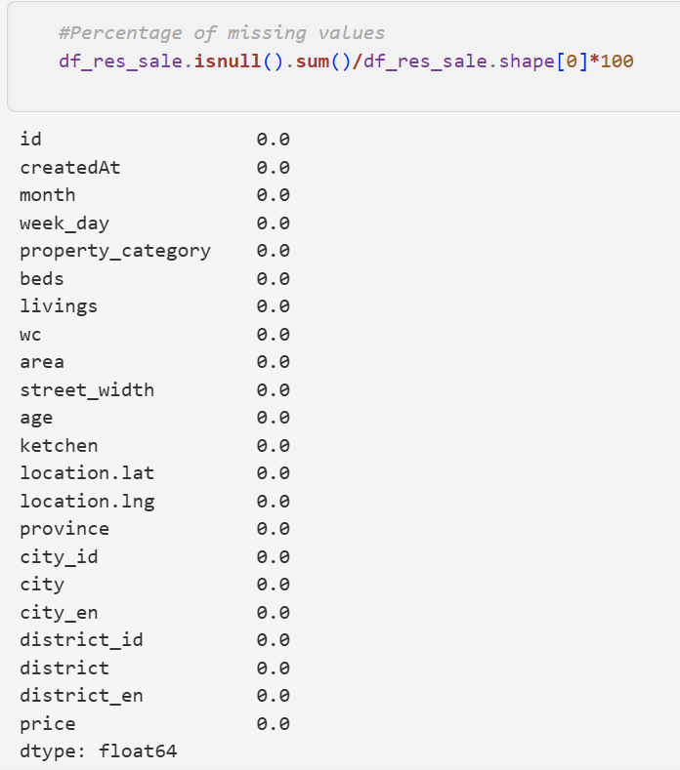
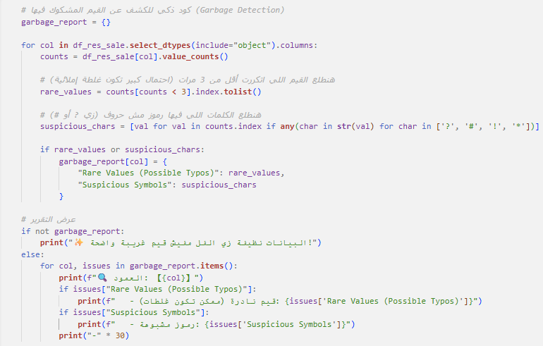
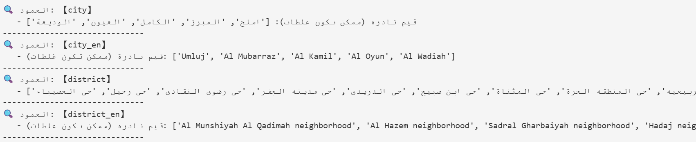
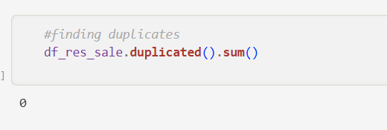
1
2
3
4
5
6
Cleaning & EDA
After dealing with missing, duplicate and gauge values

Slide 8


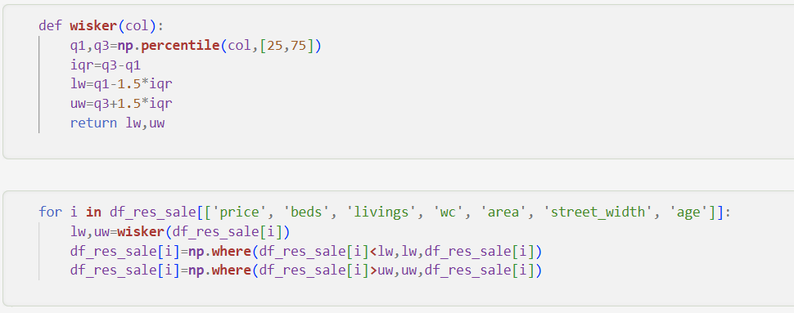
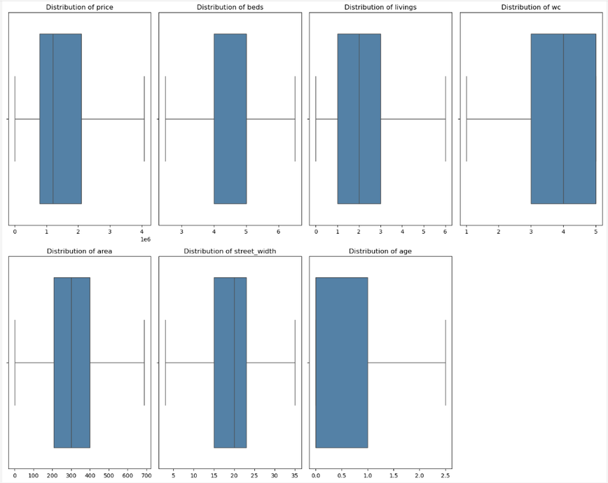
1
2
3
4
5
6
Cleaning & EDA
After dealing with outliers

Slide 9
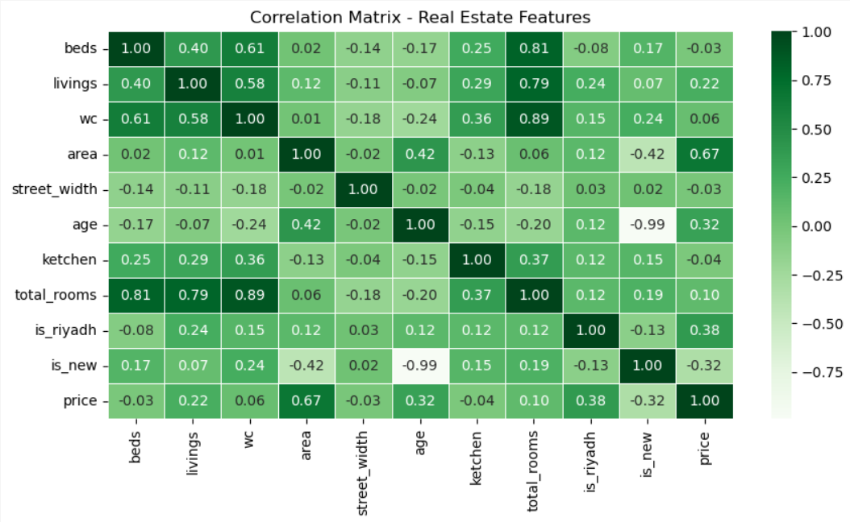
1
2
3
4
5
6
Cleaning & EDA
EDA & Market Insights
Area drives price most — 67% correlation, the strongest predictor in the dataset.
Location matters — Riyadh properties command a clear premium (38% correlation).
New is expensive — Properties aged 0–1 years carry a 32% price premium; the market rewards modern construction.
Family-sized units dominate — 4–5 bedroom layouts are the market standard, yet room count barely affects price (10%), confirming that where and how big outweigh how many rooms.
Kitchens & bathrooms are baseline — Near-zero price correlation means buyers treat them as minimum requirements, not value-adds.

Slide 10
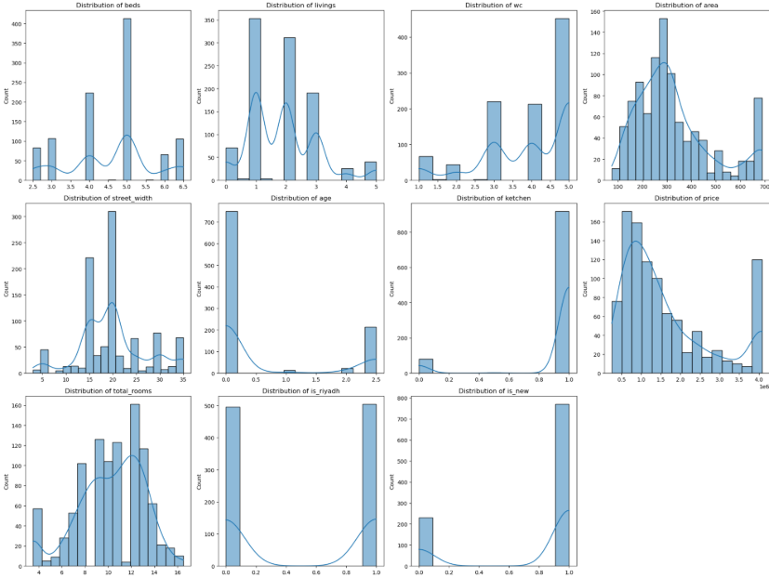
1
2
3
4
5
6
Cleaning & EDA
EDA & Market Insights
Area drives price most — 67% correlation, the strongest predictor in the dataset.
Location matters — Riyadh properties command a clear premium (38% correlation).
New is expensive — Properties aged 0–1 years carry a 32% price premium; the market rewards modern construction.
Family-sized units dominate — 4–5 bedroom layouts are the market standard, yet room count barely affects price (10%), confirming that where and how big outweigh how many rooms.
Kitchens & bathrooms are baseline — Near-zero price correlation means buyers treat them as minimum requirements, not value-adds.

Slide 11
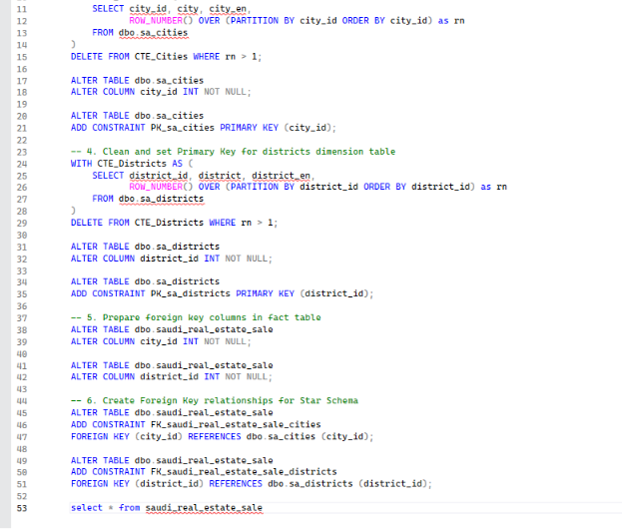
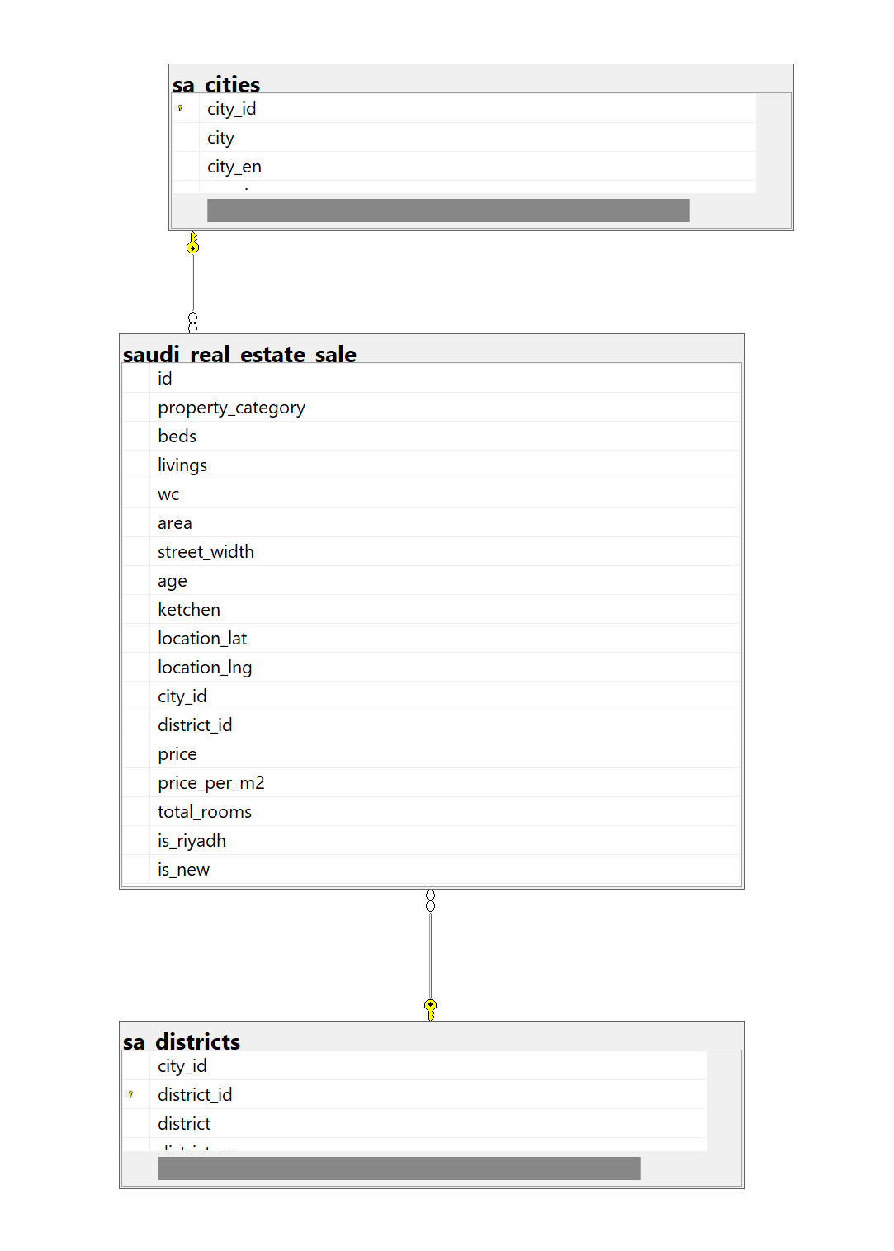

1
2
3
4
5
6
SQL Management
Database & data model creation
SQL Management: Built a clean relational Star Schema by standardizing INT keys and establishing strict Primary Key and Foreign Key constraints between the central Fact table and Dimension tables. This pushed modeling complexity to the database layer to keep Power BI fast and lightweight.

Slide 12


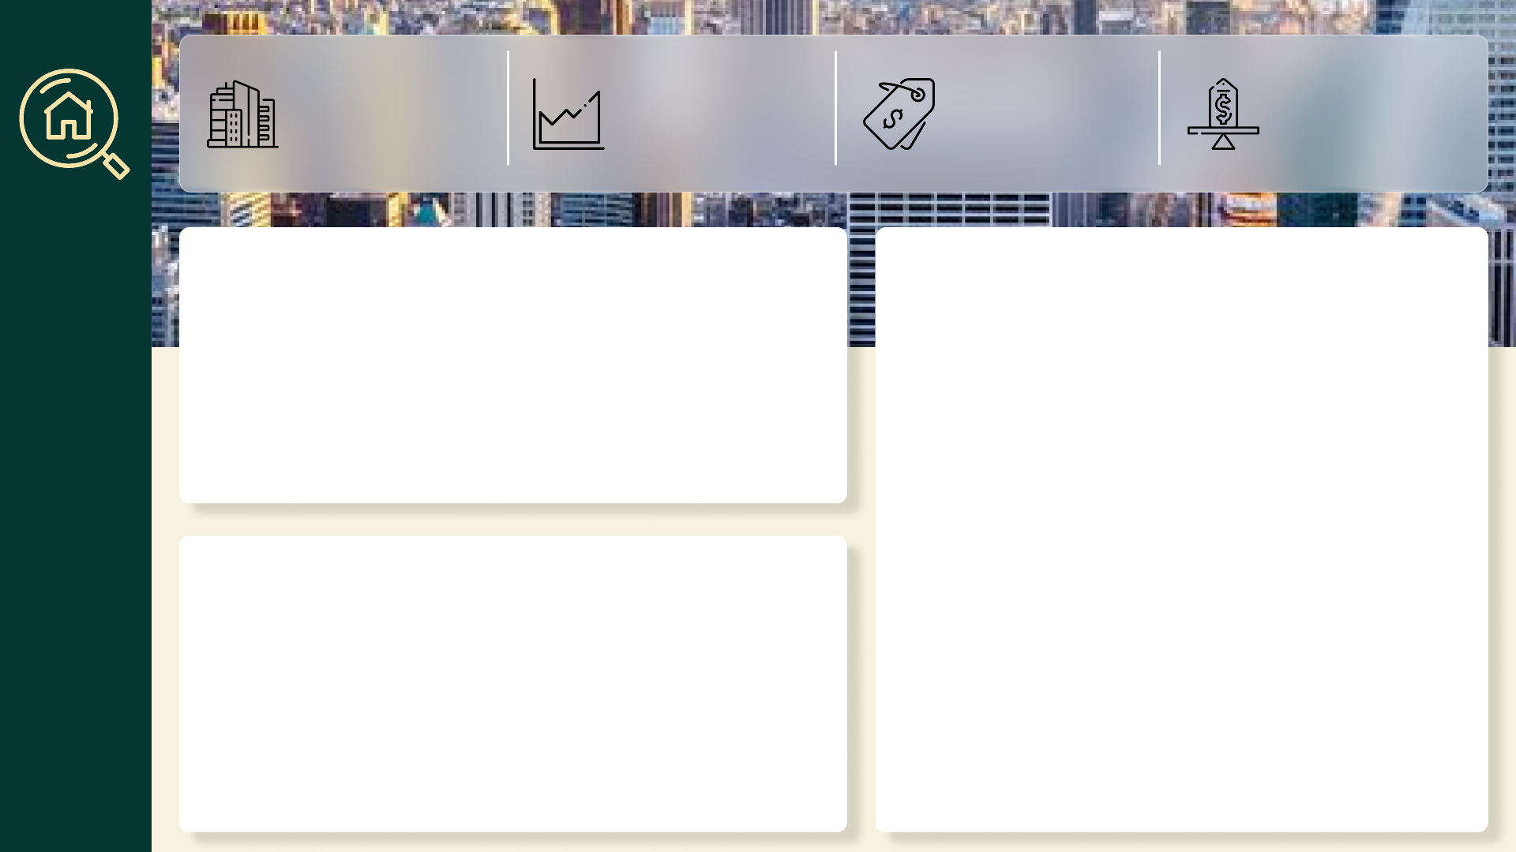
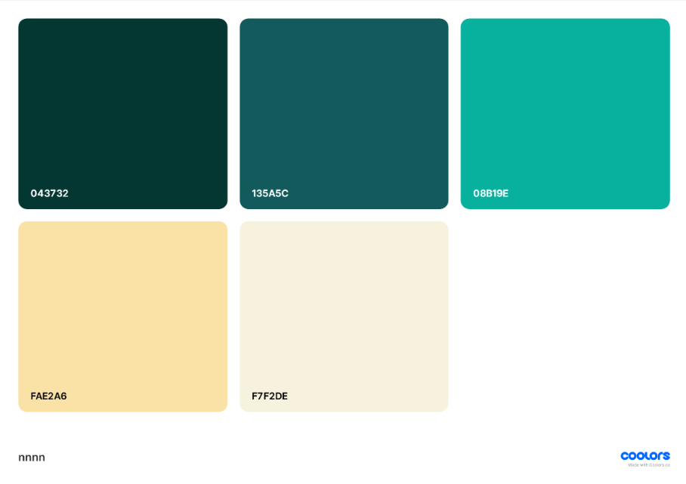
1
2
3
4
5
6
Power BI Dashboard
Dashboard Layout & Purpose
Purpose: Transforms raw data into an interactive decision-making tool, allowing any investor to explore the KSA market by budget, region, and property type — no technical knowledge needed. Fully accessible on both desktop and mobile layouts.
UI/UX Design: Designed in Figma first. Dark green & teal palette reflects Saudi national identity. Minimal typography keeps focus on the data. Logo combines a house + search lens — find the right investment. Responsive layout ensures a seamless experience across screen sizes.

Slide 13
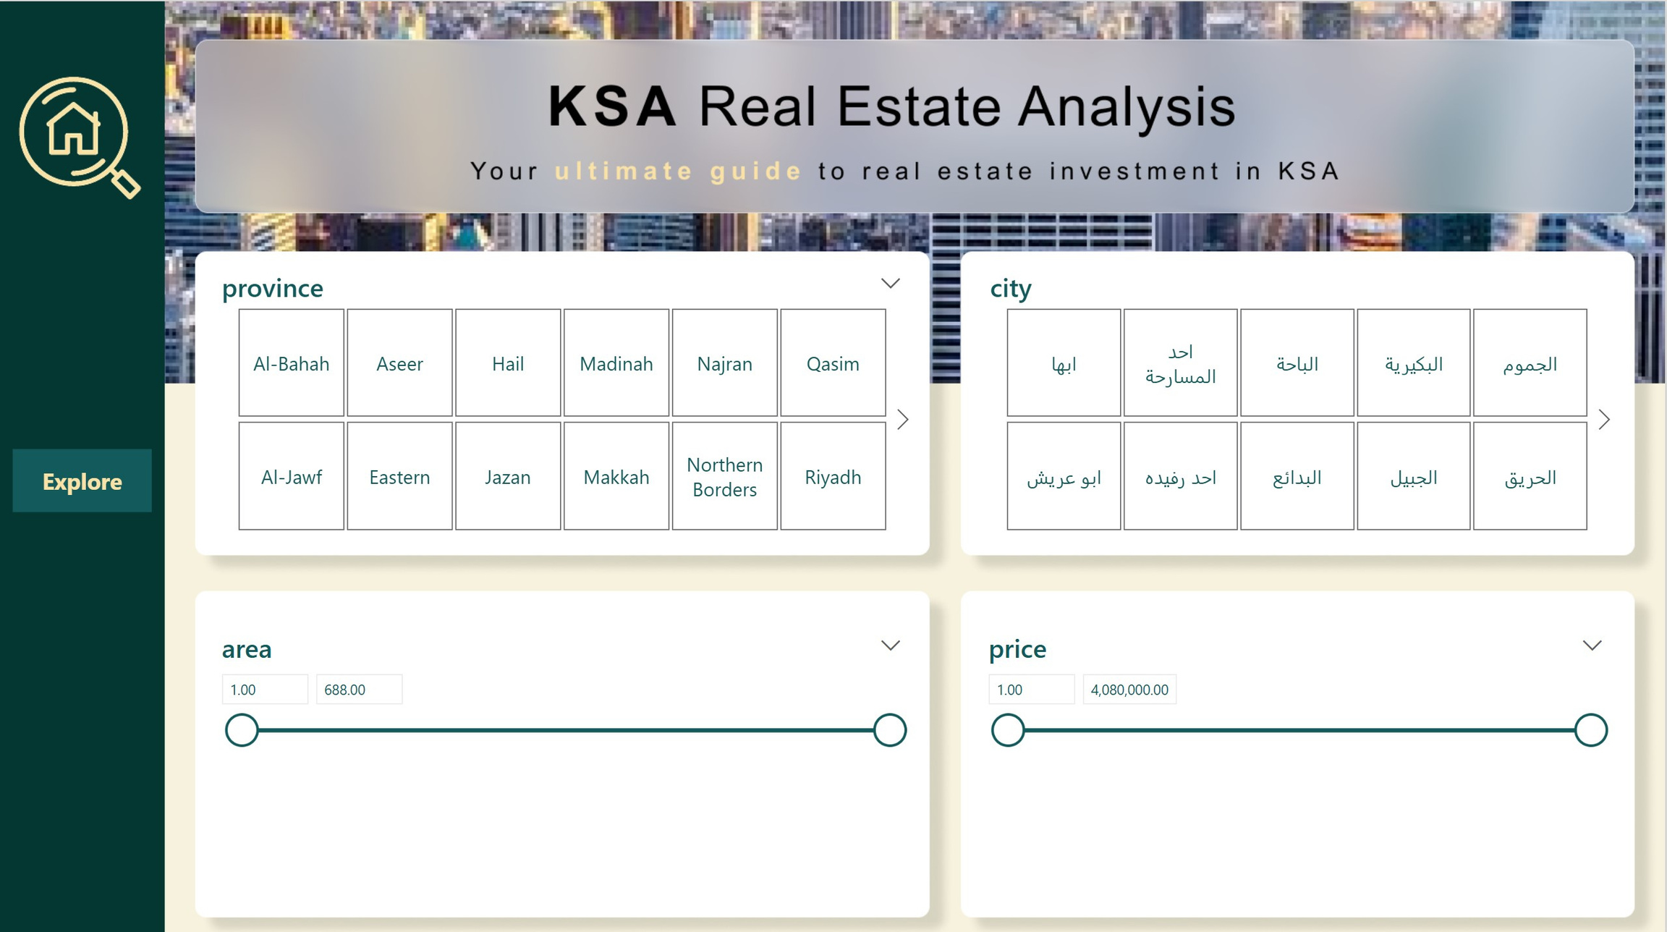

Slide 14
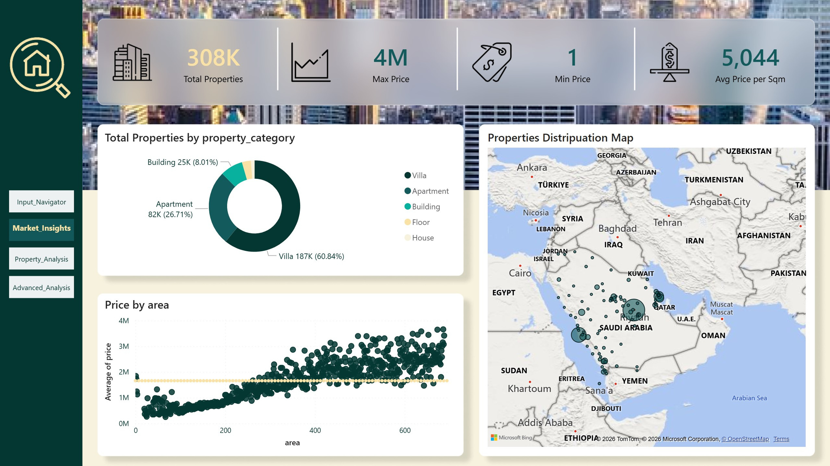

Slide 15
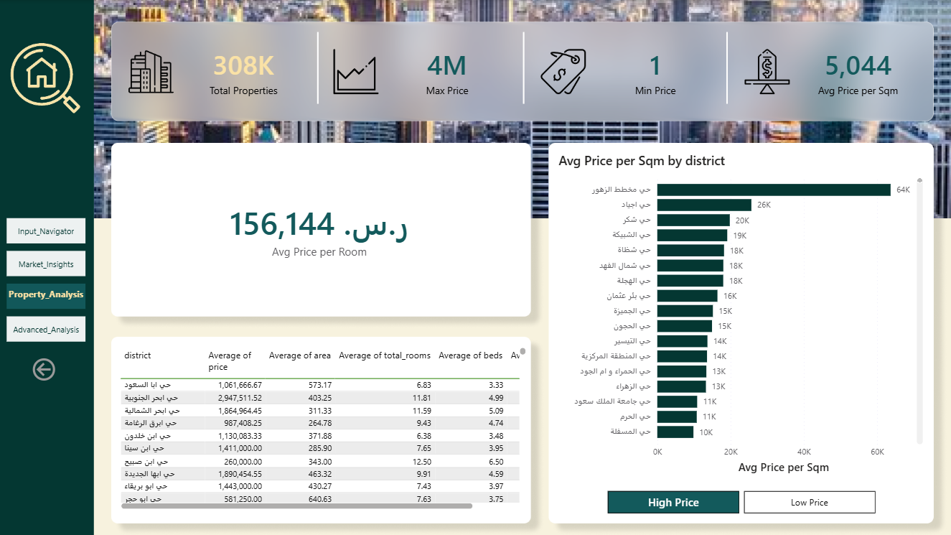

Slide 16
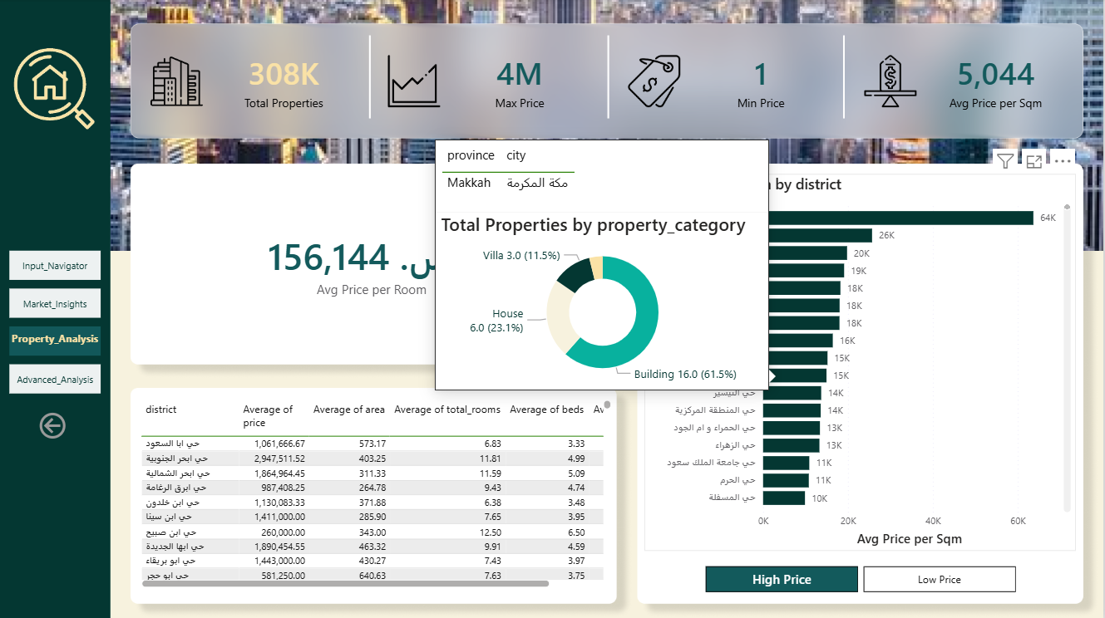

Slide 17
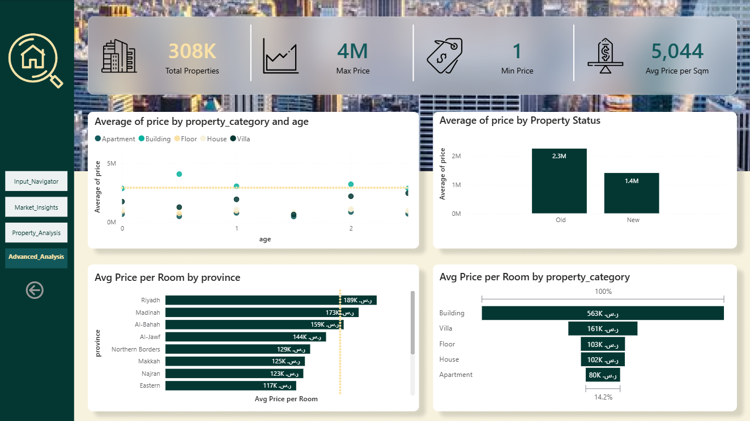

Slide 18


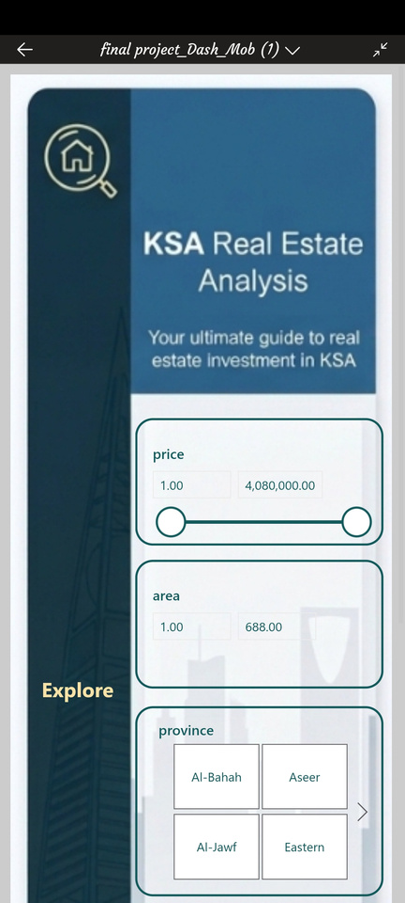
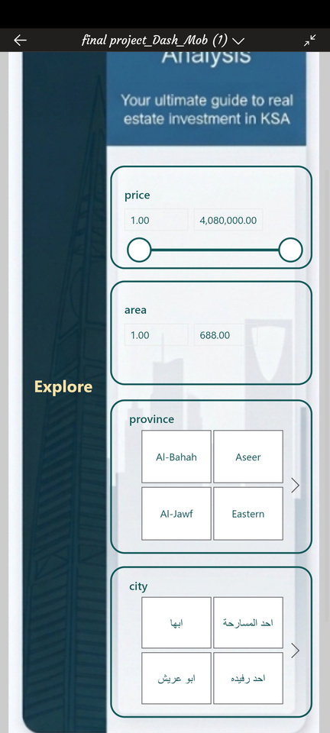
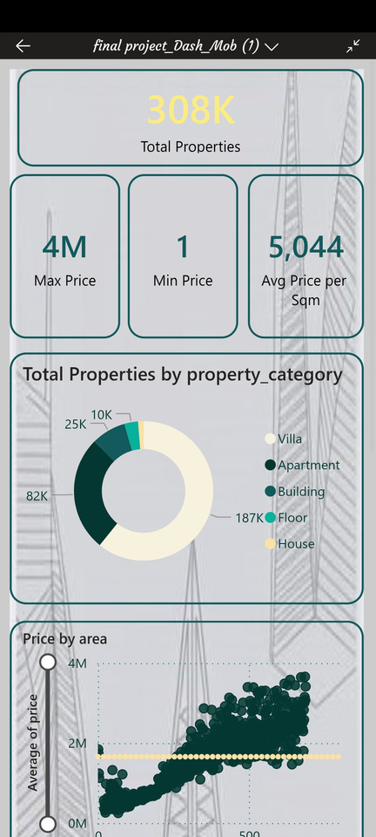
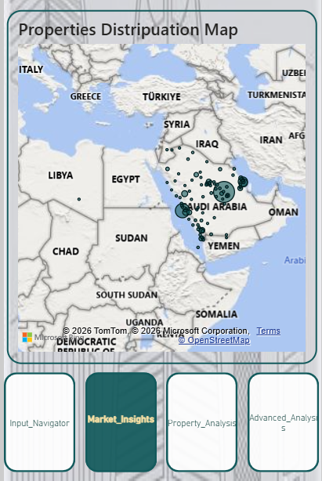
1
2
3
4
5
6
Power BI Dashboard

Slide 19
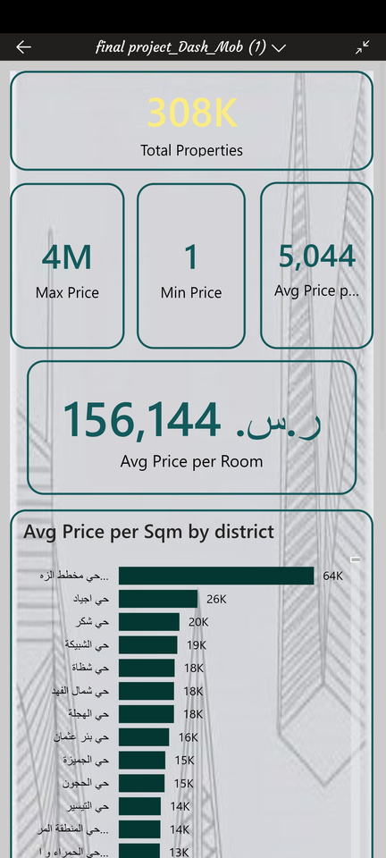
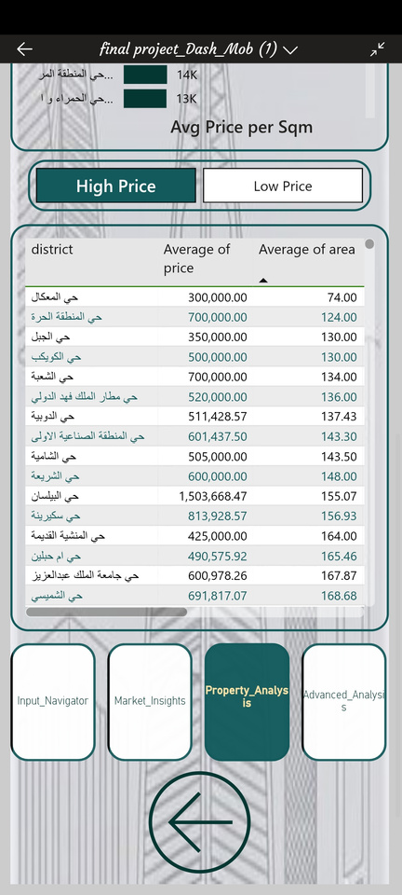
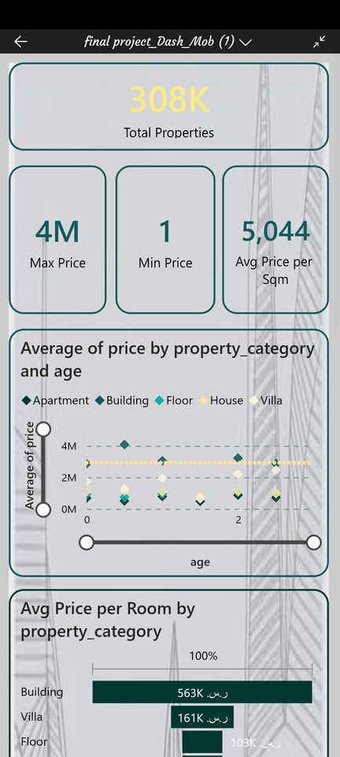
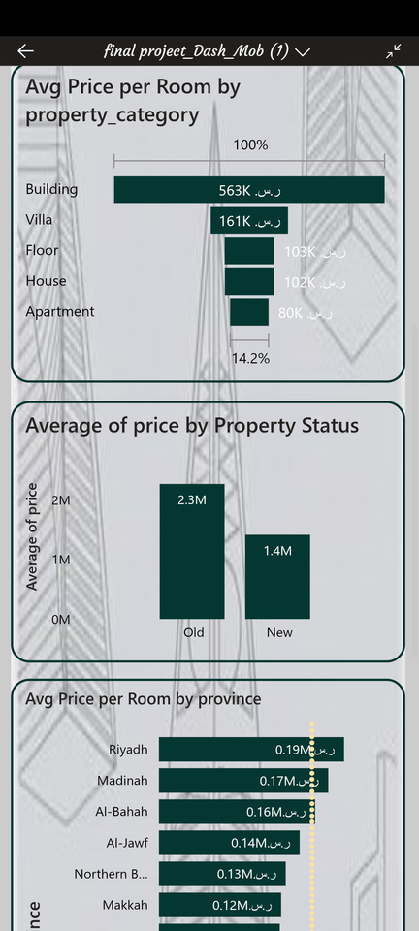
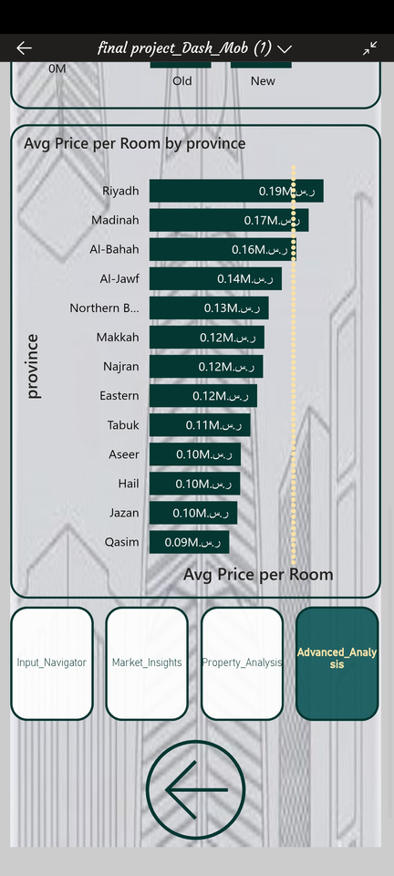
1
2
3
4
5
6
Power BI Dashboard

Slide 20



1
2
3
4
5
6
Power BI Dashboard
Key Market Insights
MARKET OVERVIEW
PRICE DRIVERS
COUNTERINTUITIVE FINDINGS
308K
189K
+61%
active listings nationwide
SAR/room — Riyadh, top province
old properties priced above new builds
Prices span 1 SAR to 4M SAR — a vast, highly fragmented market
Villas dominate at 60.84% of listings — a deeply family-centric market
Avg 5,044 SAR/sqm reflects demand concentrated near the capital and religious cities
Area is the strongest price predictor — larger properties command higher prices across all categories
Madinah (173K) and Al-Bahah (159K) follow Riyadh among top provinces by price/room
Mahatat Al Zuhur is the most premium micro-location at 64K SAR/sqm — nearly 3x the next highest
Buildings hit the highest price/room at 563K SAR — 3.5x villas, marking them investment-grade
Room count shows only 10% correlation with price — size and location matter far more
Kitchens & bathrooms are fully standardized, adding no measurable price premium

Slide 21
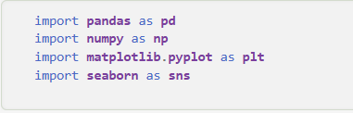
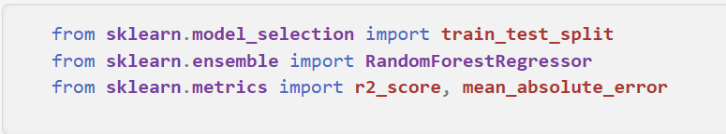
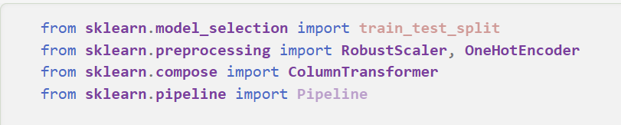
1
2
3
4
5
6
ML model
Overview
After uncovering the key KPIs driving the Saudi real estate market, the next step was to move from observation into prediction. The Machine Learning component of the Intelligent Investment Consultant is a Random Forest Regressor trained to predict residential property prices across KSA based on physical and geographic specifications — transforming the dashboard from a retrospective analysis tool into a forward-looking investment advisor.
Library Selection
The model was built using a carefully selected set of Python libraries, each chosen for a specific role in the machine learning pipeline.

Slide 22
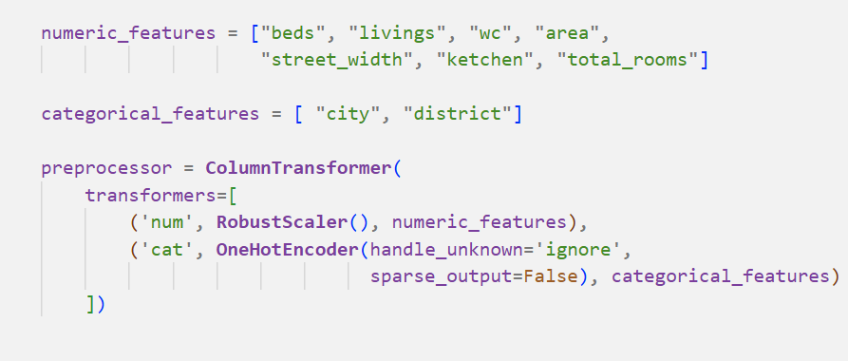
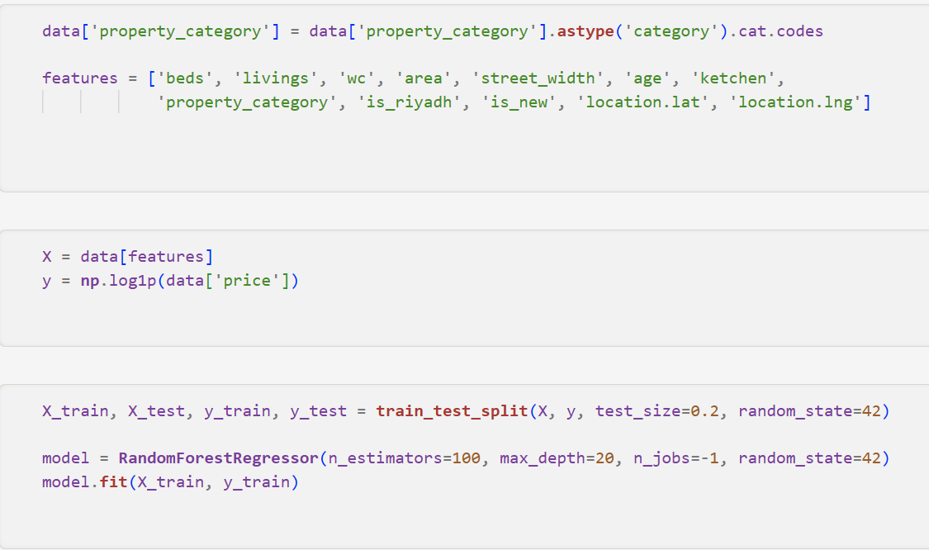
1
2
3
4
5
6
ML model
Preparing the Data
Before any model can learn, the data must be structured in a way the algorithm can genuinely work with. This preparation stage involved four critical decisions:
Convert text labels into numeric codes the model can process
Retain only features with genuine predictive signal for price
Compress the skewed price distribution and reduce impact of extreme outliers.
Reserve 20% of data as unseen test set for honest evaluation

Slide 23
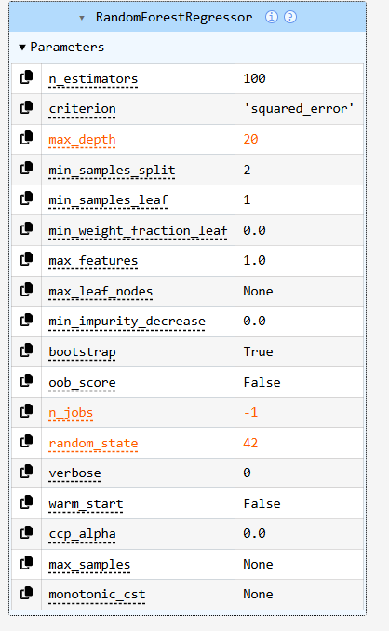
1
2
3
4
5
6
ML model
Training the Model
Parameter / Action | Value / Method | Purpose
Model initialization | RandomForestRegressor(...) | Create an ensemble of independent decision trees for robust price prediction
n_estimators | 100 | Build 100 trees to reduce variance through averaging without excessive compute cost
max_depth | 20 | Cap tree depth to prevent overfitting while retaining capacity for complex patterns
n_jobs | -1 | Use all available CPU cores to handle 300K+ records efficiently during training
random_state | 42 | Ensure reproducible results across runs
Model fitting | model.fit(X_train, y_train) | Train all 100 trees on the 80% training partition

Slide 24
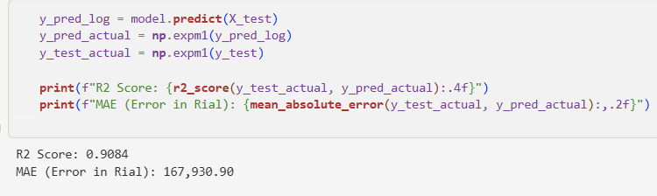
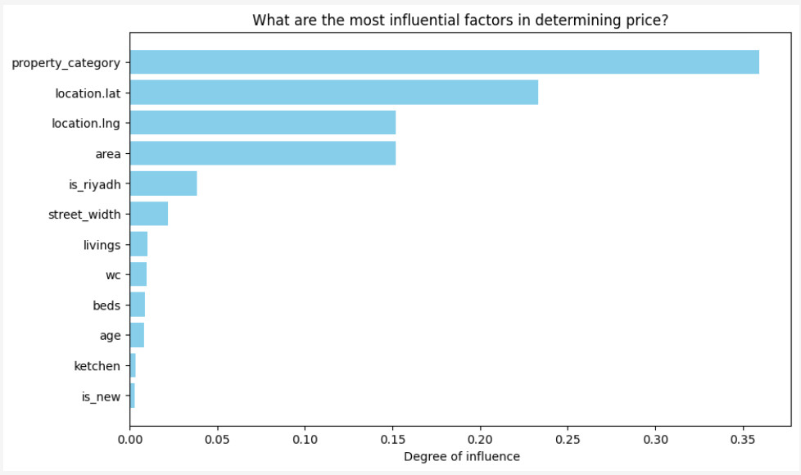
1
2
3
4
5
6
ML model
Results & Model Evaluation
After training, predictions were converted back from log-scale to actual SAR values using expm1 before computing all metrics. The model achieved the following results on the held-out 20% test set
In addition to a feature importance chart was generated, ranking all twelve input features by their contribution — with area, location coordinates, and age consistently topping the list, validating the EDA findings.

Slide 25
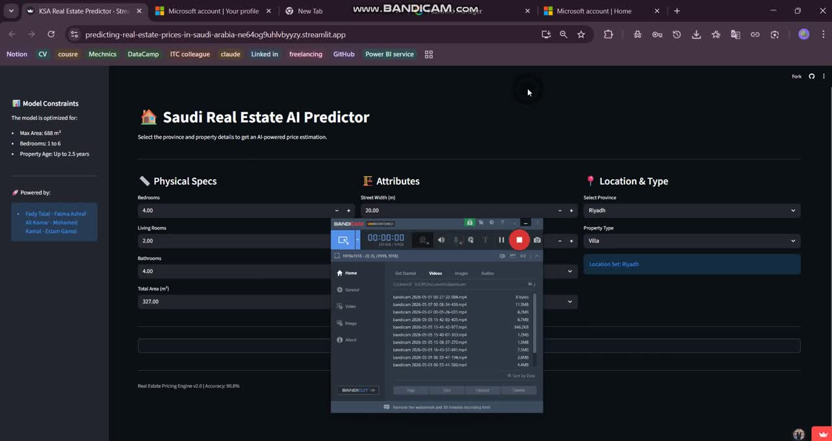

Slide 26
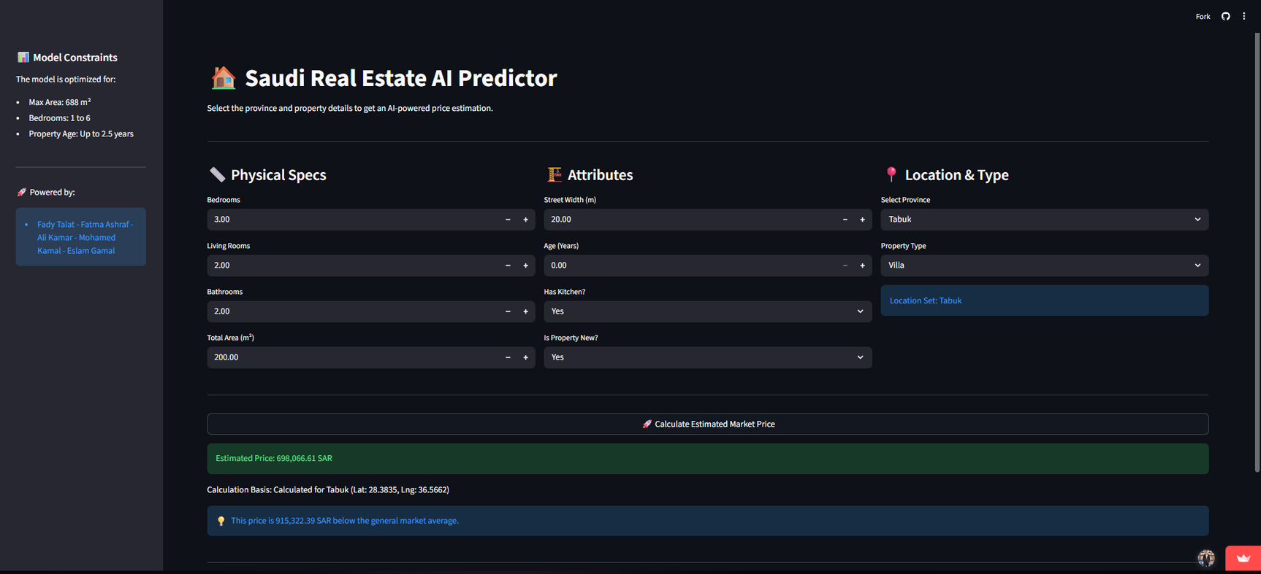
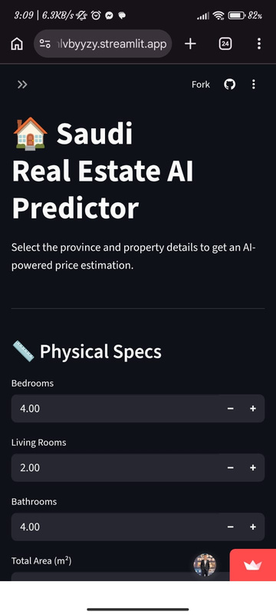
1
2
3
4
5
6
ML model
AI Price Predictor
Try it by yourself and see which property deal suits you

Slide 27

1
2
3
4
5
6
Conclusion
Conclusion
The Intelligent Investment Consultant
The Scale: 300k+ Listings | 13 Provinces | Unified Database.
The Tech: Power BI Dashboard + ML-Powered Streamlit App.
The Accuracy: 90.84% Precision in Property Valuations.
The Mission: Turning complex market information into confident, data-backed decisions.

Slide 28

Team Members
Fady Talat Abdallah
Team leader
Fatma Ashraf Zain
Ali Kamar
Mohamed El Ashmawy
Eslam Gamal

Slide 29
KSA Real Estate Analysis
Q&A
Any burning questions

Slide 30
KSA Real Estate Analysis
Thank you for your interset
Your ultimate guide to real estate investment in KSA.

